Slide 1
Word2Vec
Since we’re using the keywords from songs to retrieve images with tags associated with them, we need to find a way to compare them
Most modern ML algorithms don’t deal with strings directly
This is where word2vec comes in: it takes words and converts them to a point in a n-dimensional vector space
The model we train can be used to determine how similar the keyword is to the tags of the images so that we can pick the “best” (relevant) image

Slide 2
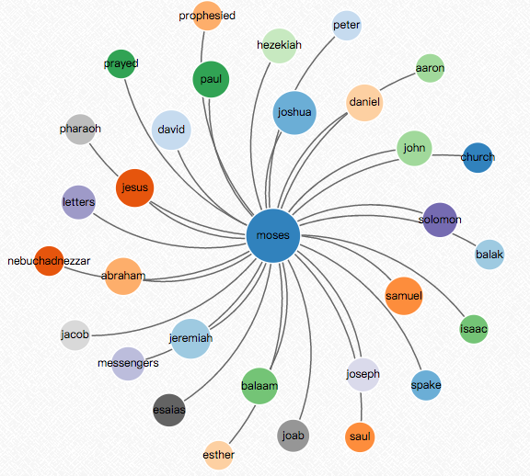
We can see which words are close to each other

Slide 3
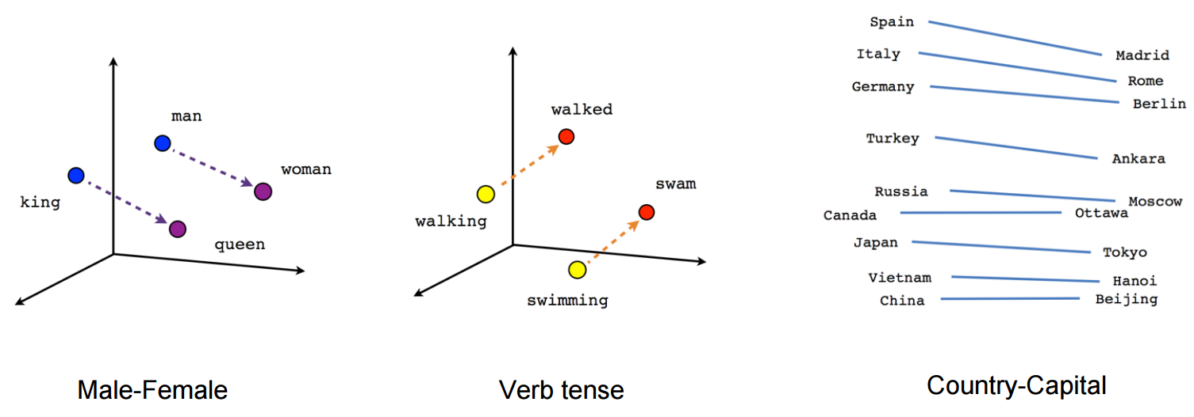
This is essentially what it’s doing: words with similar relationships (king and queen or man and woman) have similar euclidean distances between them

Slide 4
Development Updates
We were able to get a running algorithm to find the most relevant image for each paragraph
Ran it through a few times to find errors
We’ve done the manual search using pixabay to see how well it’s doing

Slide 5
Manual Search vs Algorithmic Version
Manual: https://docs.google.com/document/d/10HvHlIFRJy6NmU9uxNbhjY92KNjwS3qWGhpdtbY_GE4/edit?pli=1
Algorithmic: https://github.com/michael1albq/DataStories

Slide 6
Challenges & Next Steps & Outline
Dealing with any more potential errors through testing and debugging
Creating the second algorithm (where we have a keyword mapped to an image and the song maps to all the images)
Need to change the dataset we use since it can only obtain a limited number of pictures for many keywords and none for many other keywords → so we’re losing a lot of information
Implementation Of multithreading for faster image retrieval

